Slide 1

Information management system project
By James Monks MSci

Slide 2
Project aims
My main objective was to develop a functioning inventory management application with features relating to:
- customers
- orders
- items
I used a variety of technologies including for designing and building the application including:
- Jira
- Mysql (GCP instance)
- Java (developed in eclipse)
- Maven
- Junit
- GitHub

Slide 3
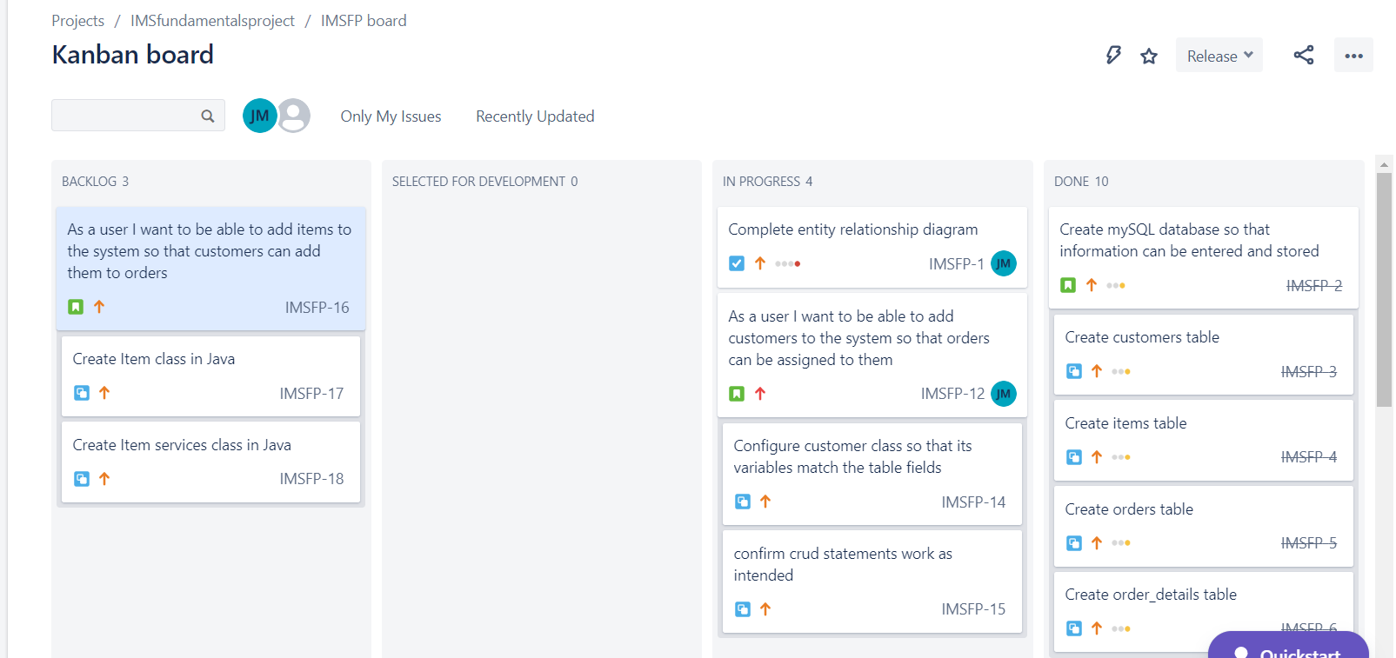
Jira board

Slide 4
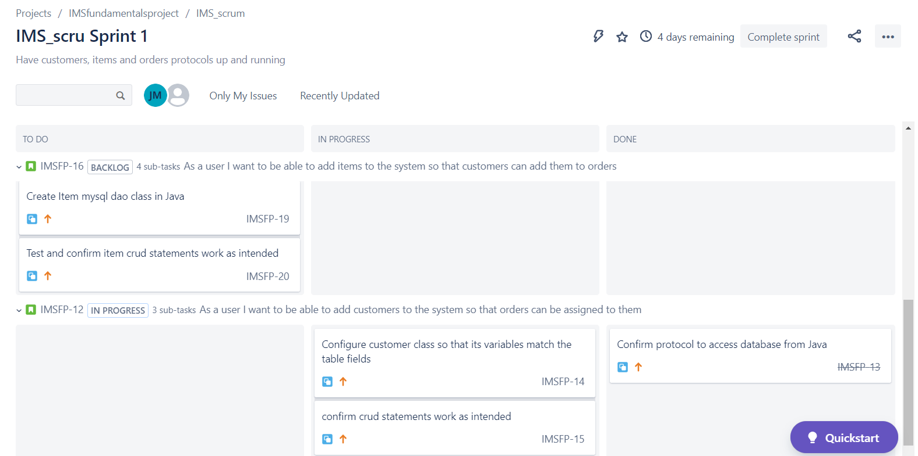
Jira board

Slide 5
Database design
Order details
Field | Variable type
FK item_ID | Int
FK_orderID | Int
Total_price | Dec(7,2)
quantity | Int
Customers Table
Field | Variable type
PK cust_ID | Int
First_name | Varchar(40)
Last_name | Varchar(40)
Username | Varchar(40)
password | Varchar(40)
Orders Table
Field | Variable type
PK Order_ID | Int
FK cust ID | Int
Totalcost | Dec(7,2)
0..N
1..N
1
1
1..N
0..N
Items table
Field | Variable type
PK item_ID | Int
Item name | Varchar(60)
Quantity_in_stock | Int
item_price | Dec(7,2)

Slide 6
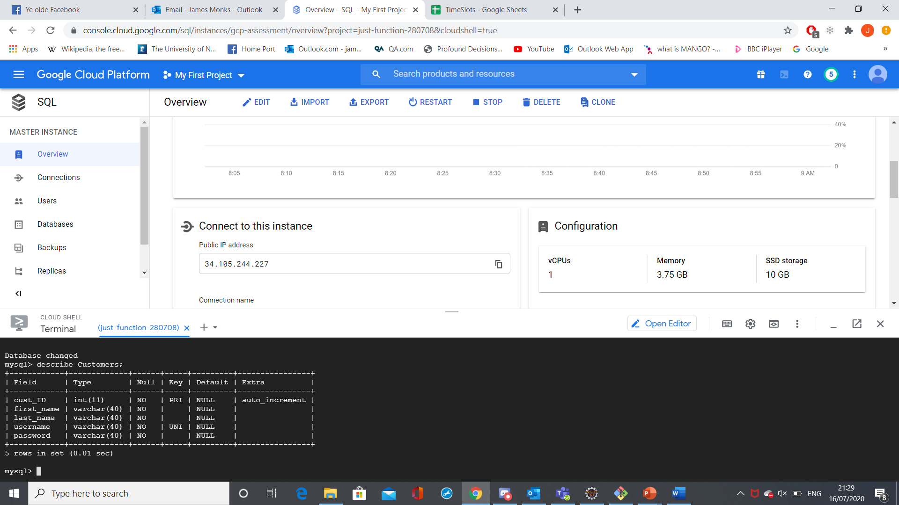
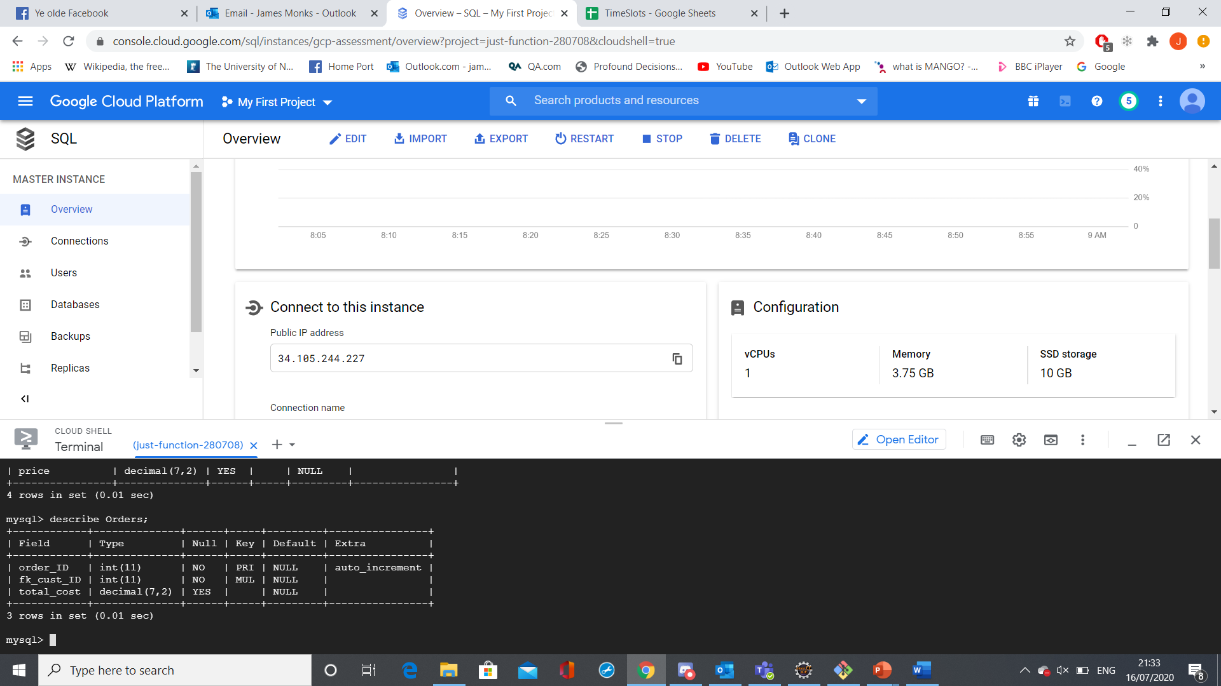
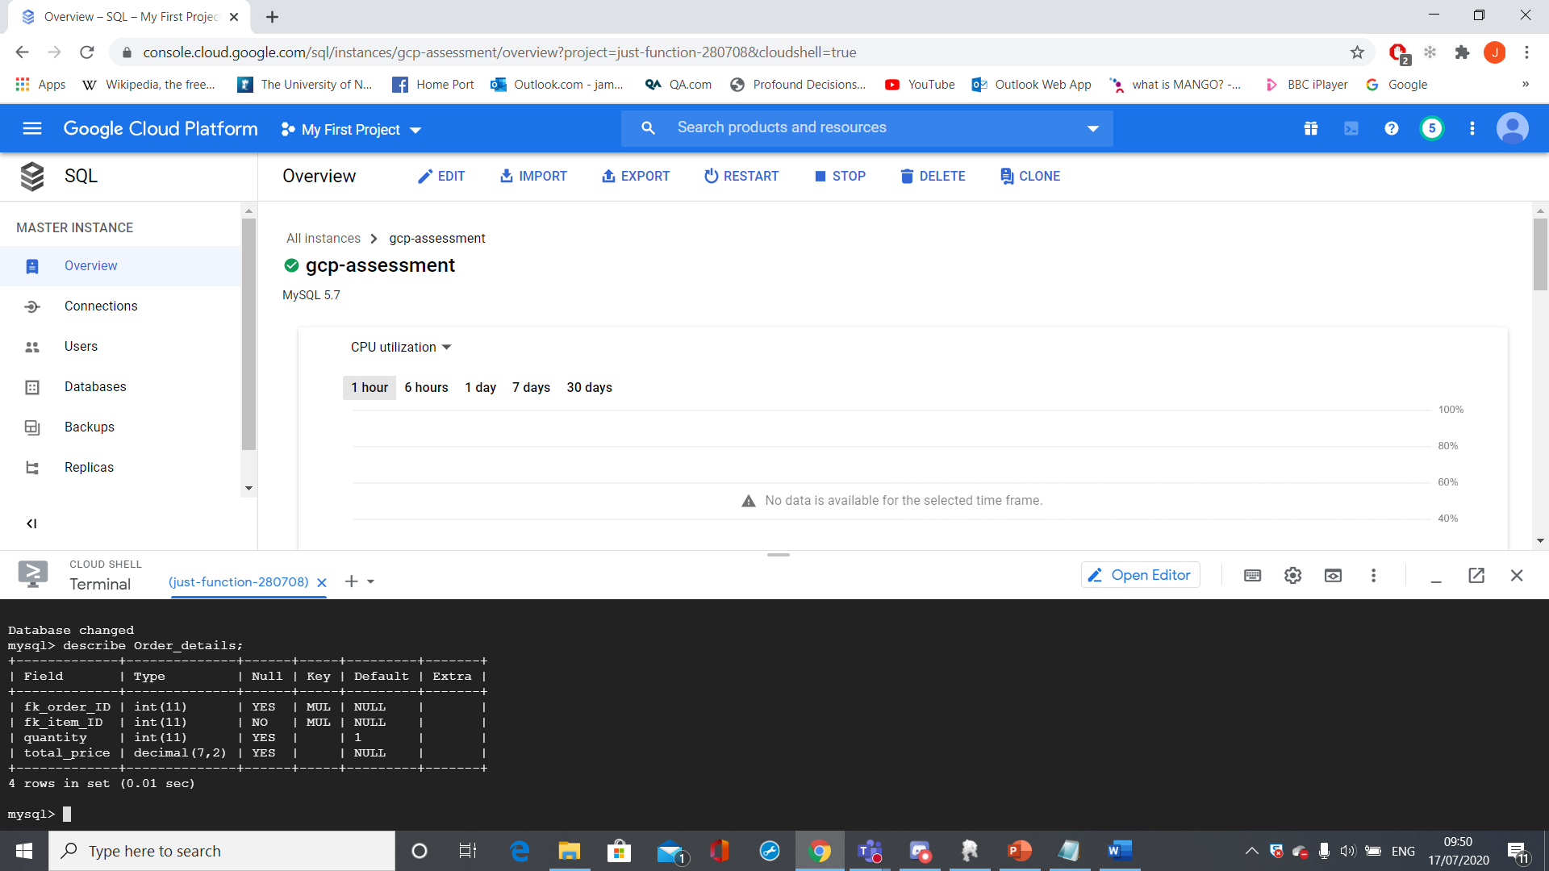

Schema

Slide 7
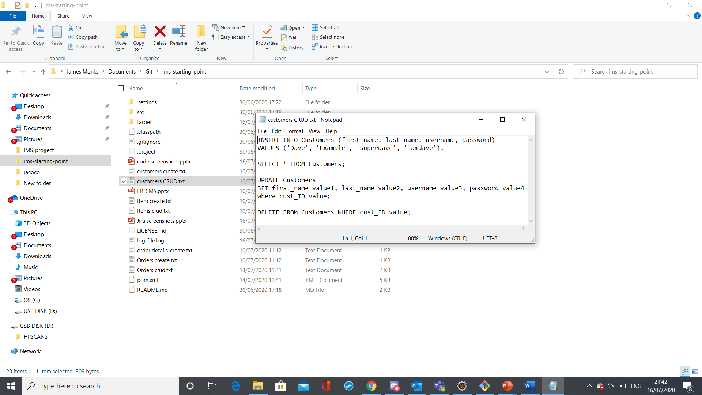
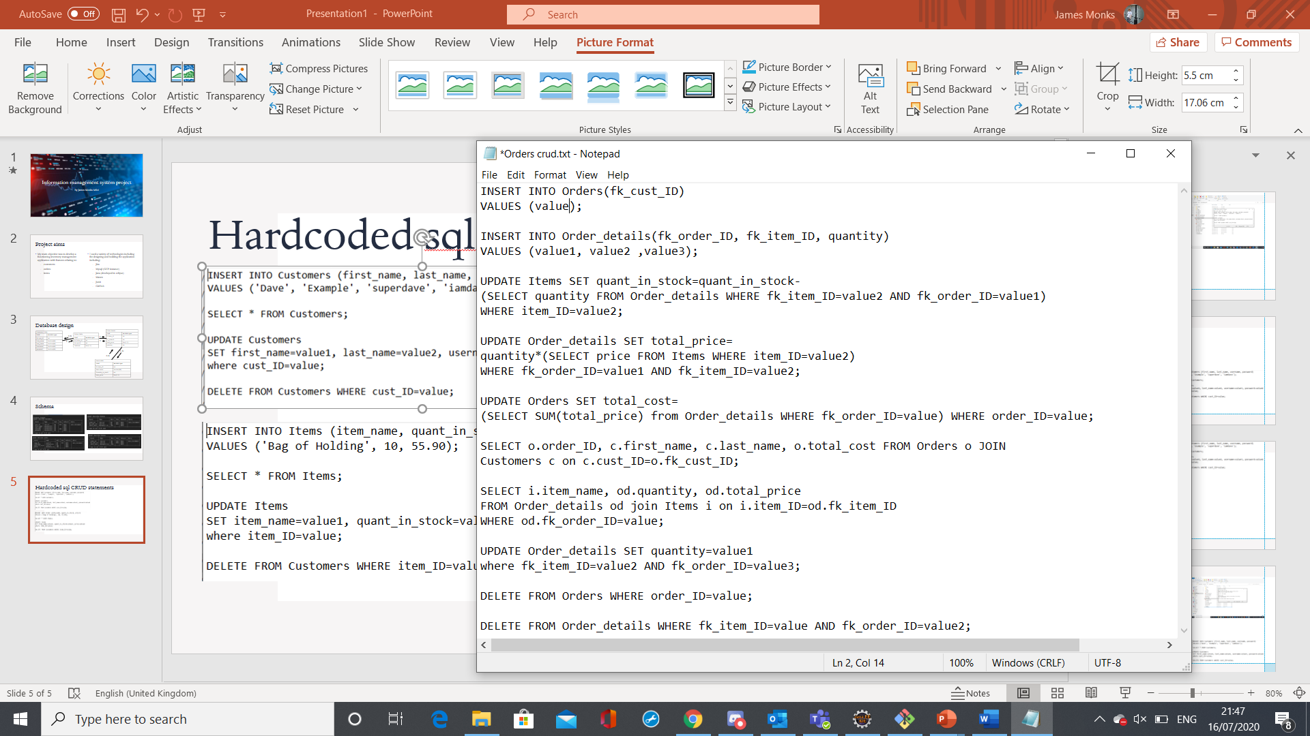
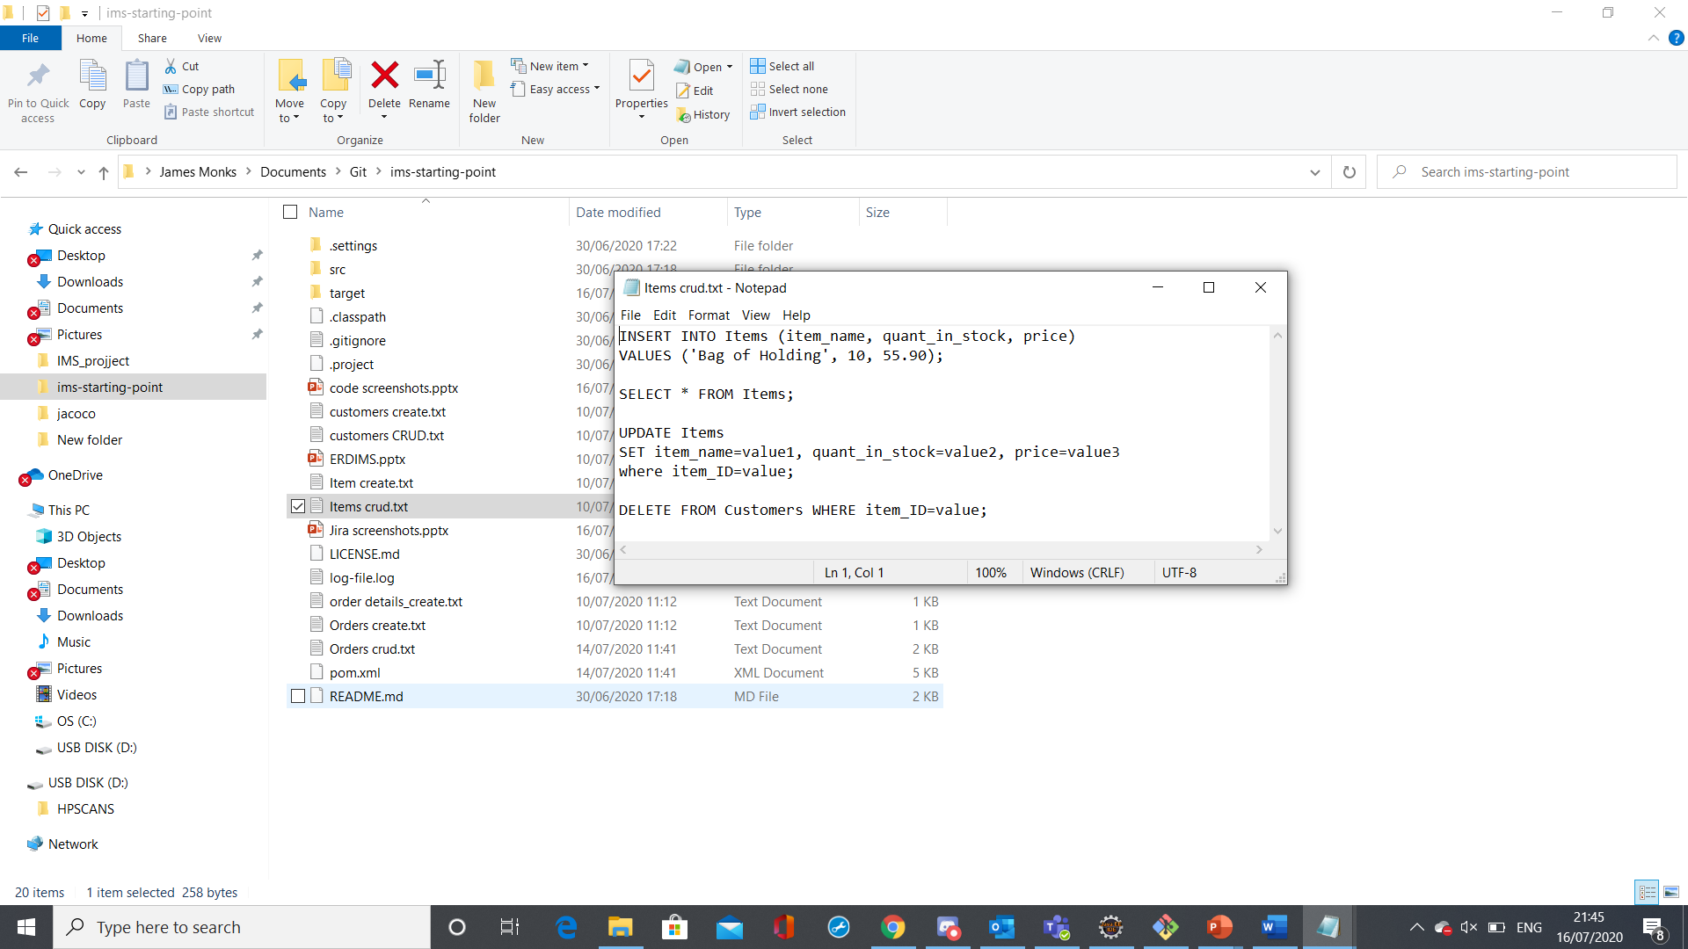
Hardcoded sql CRUD statements
Customers
Orders
Items

Slide 8
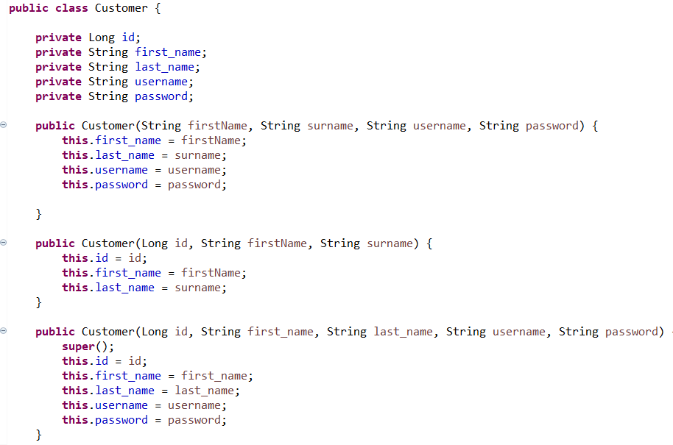
Customer class modification

Slide 9
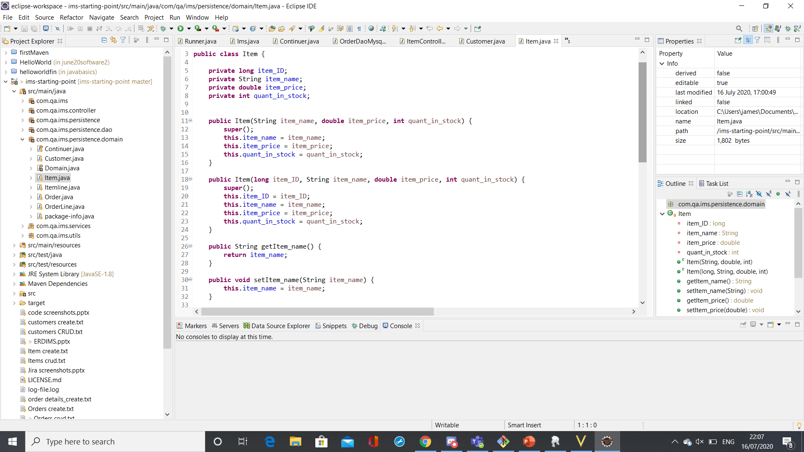
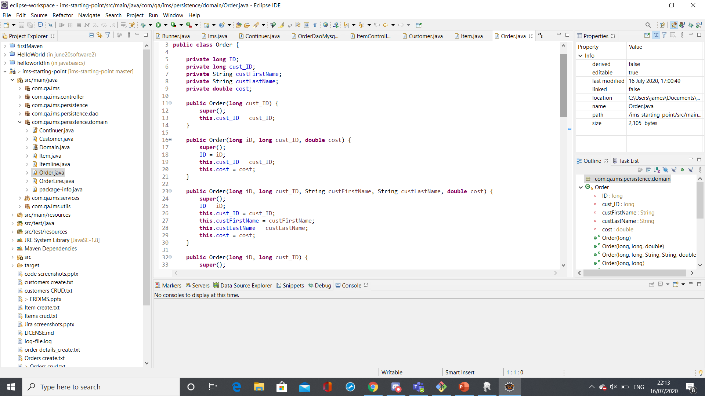
Item and order classes

Slide 10
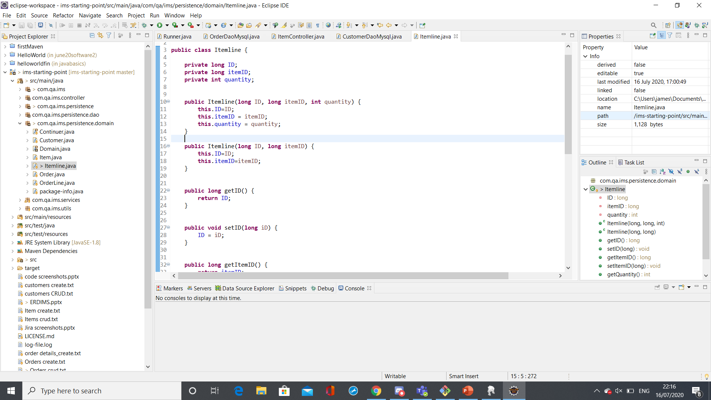
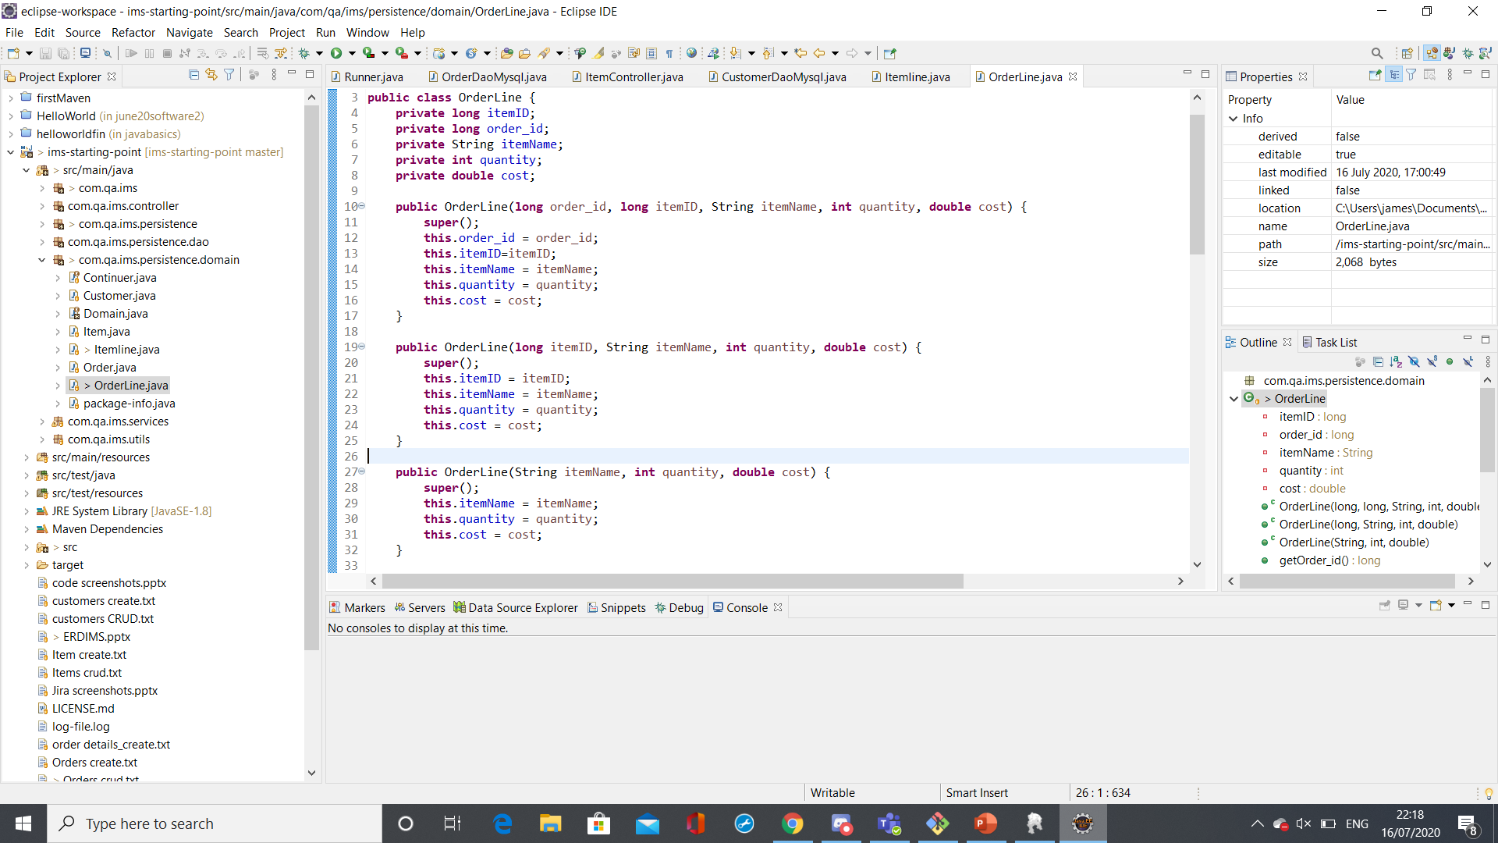
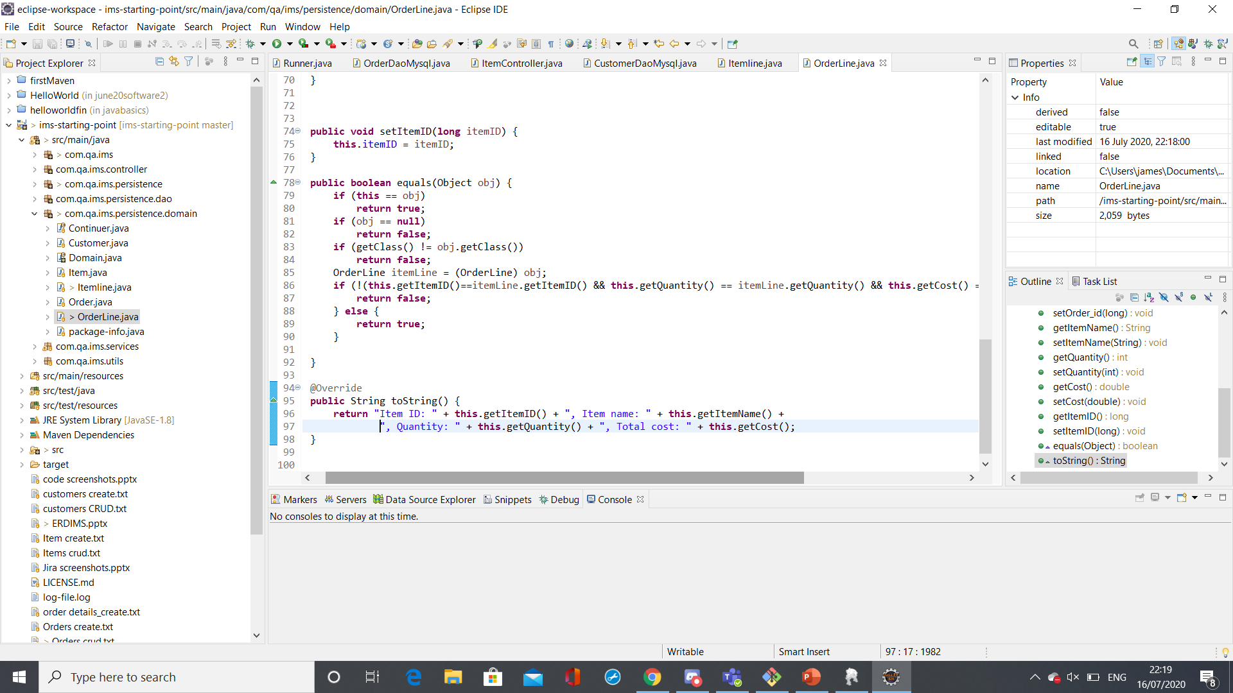
Itemline and OrderLine

Slide 11
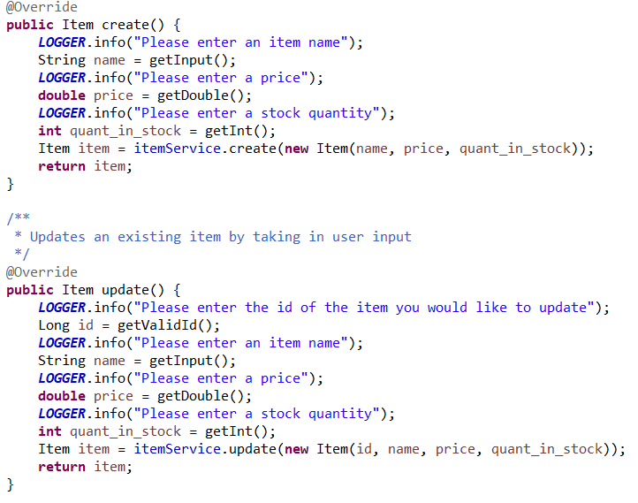
Item Controller

Slide 12
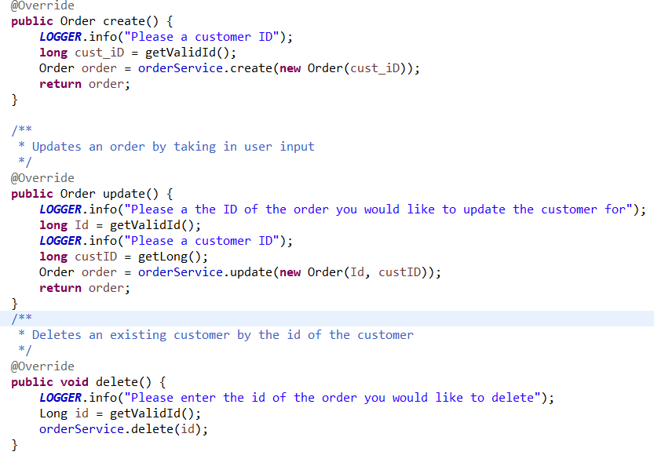
Order controller

Slide 13
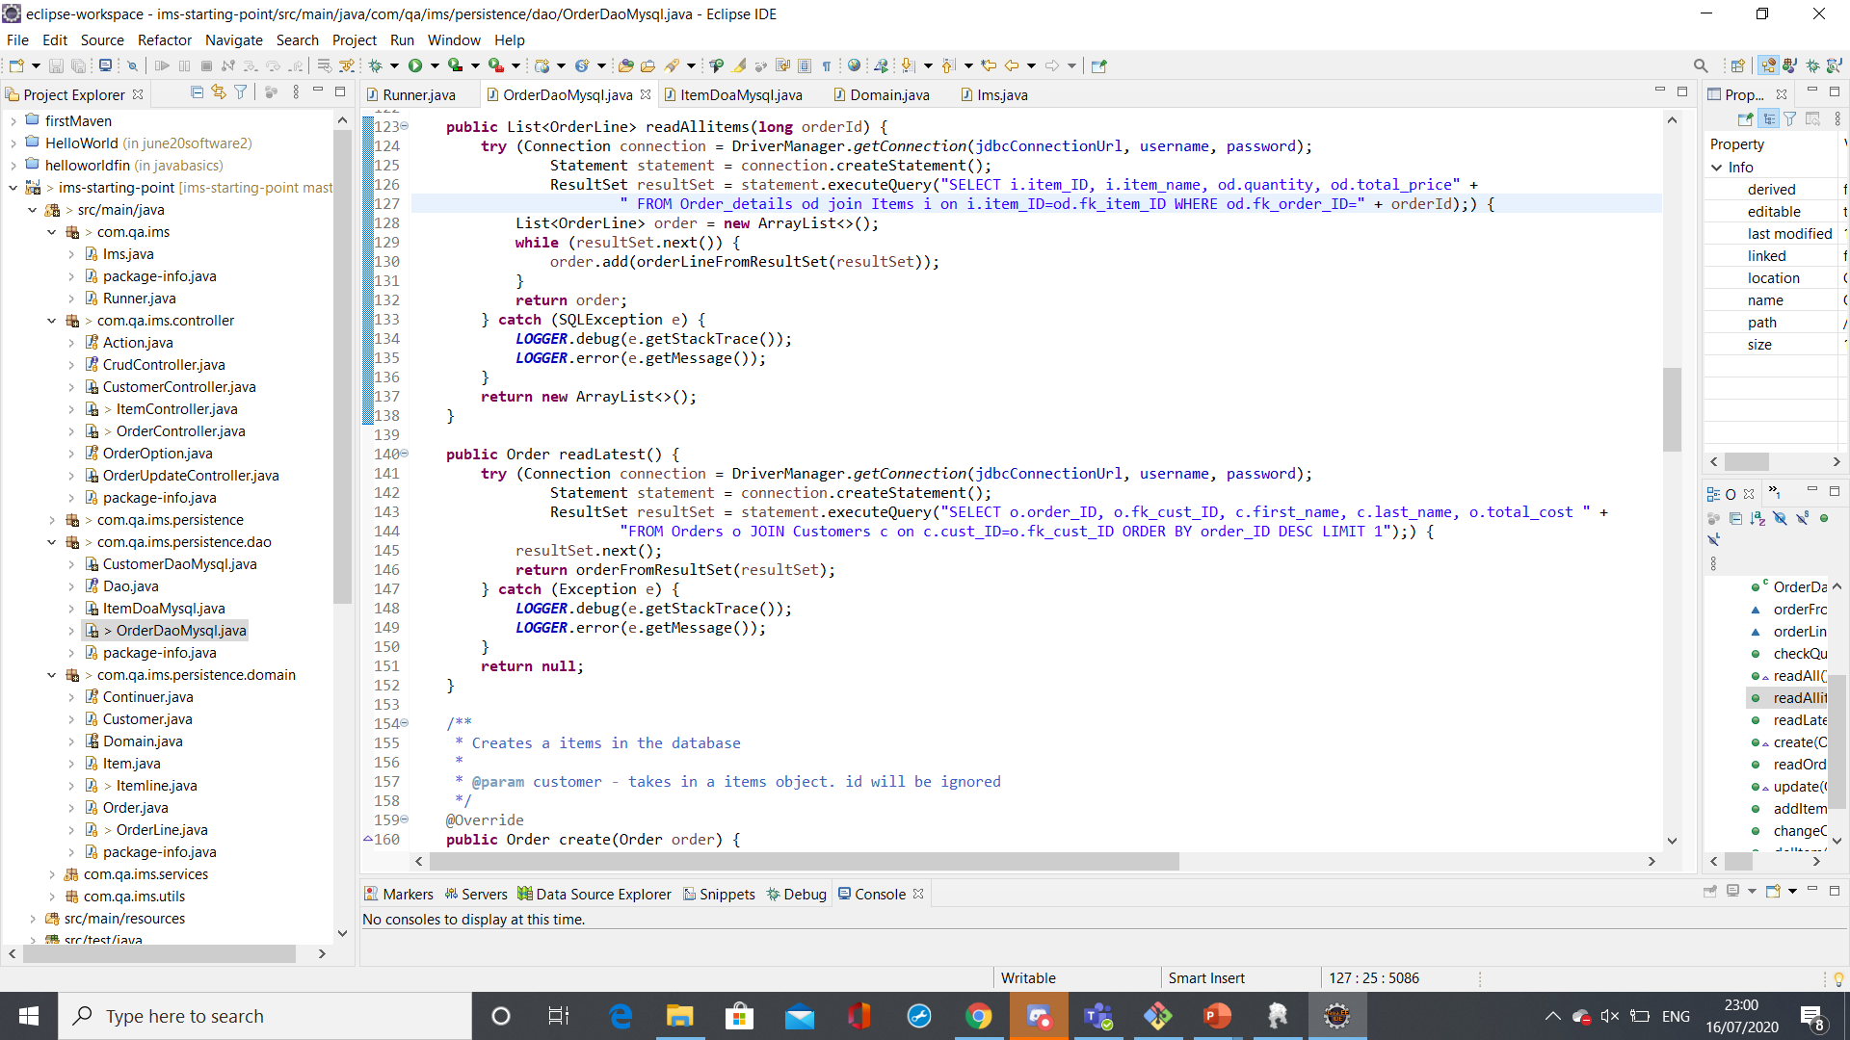
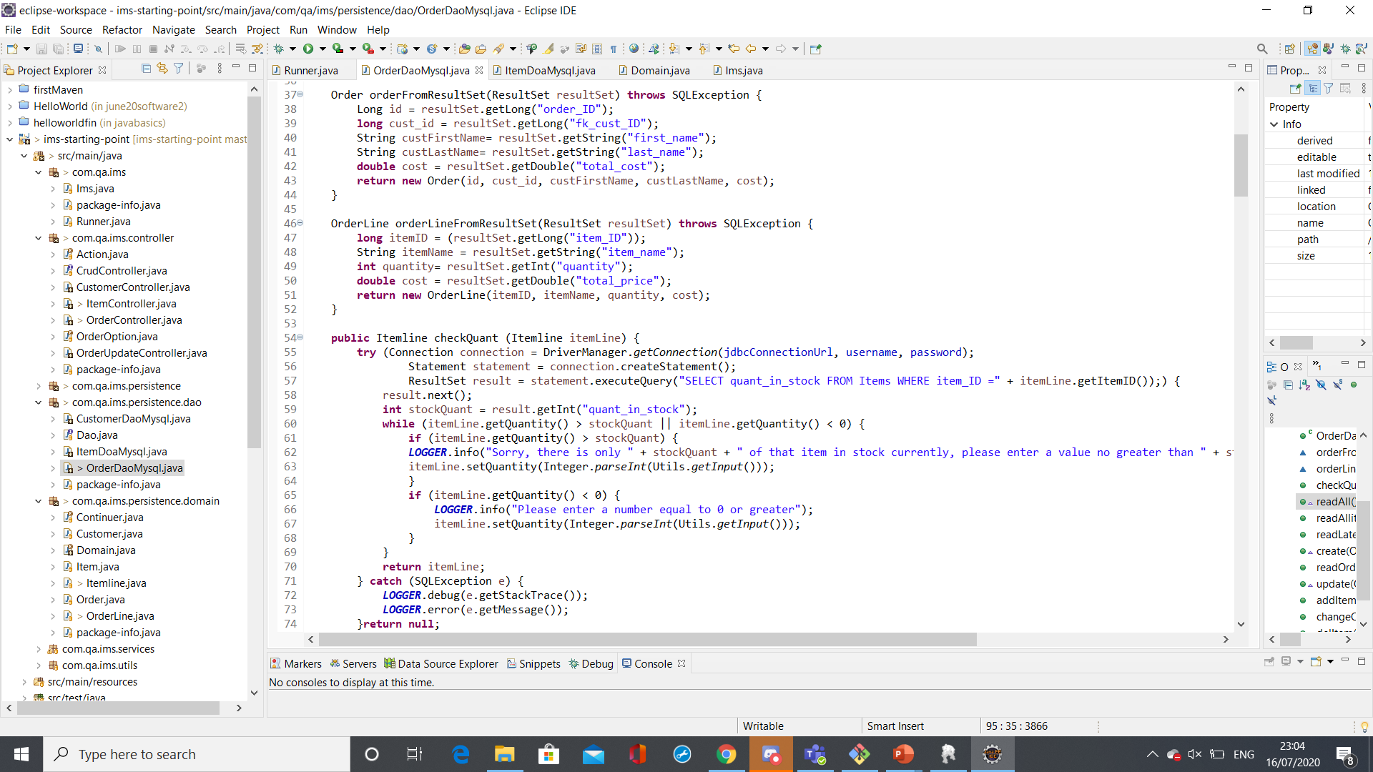
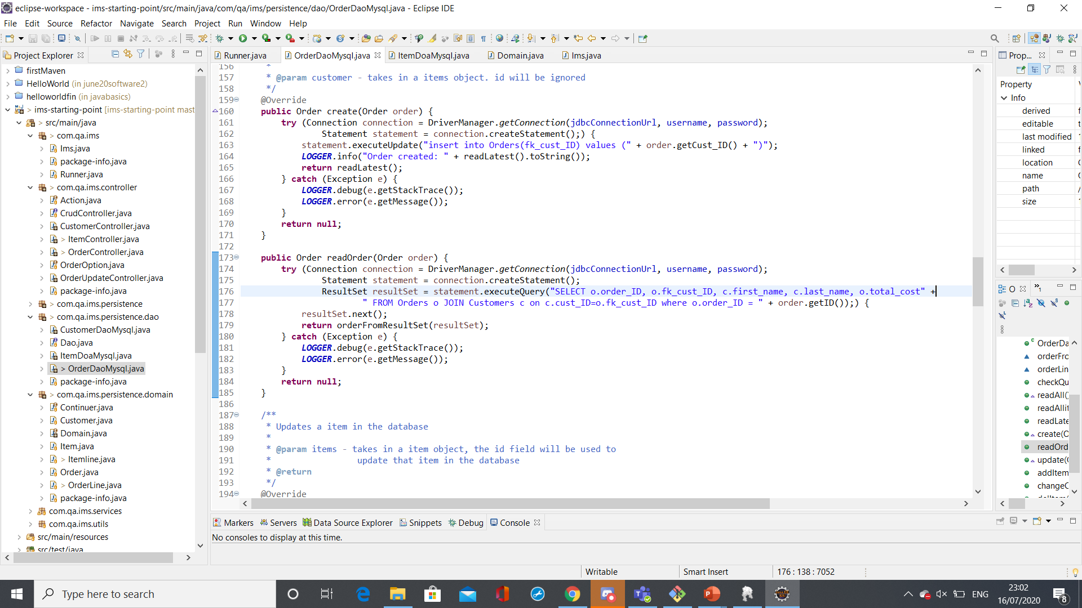
Order read

Slide 14
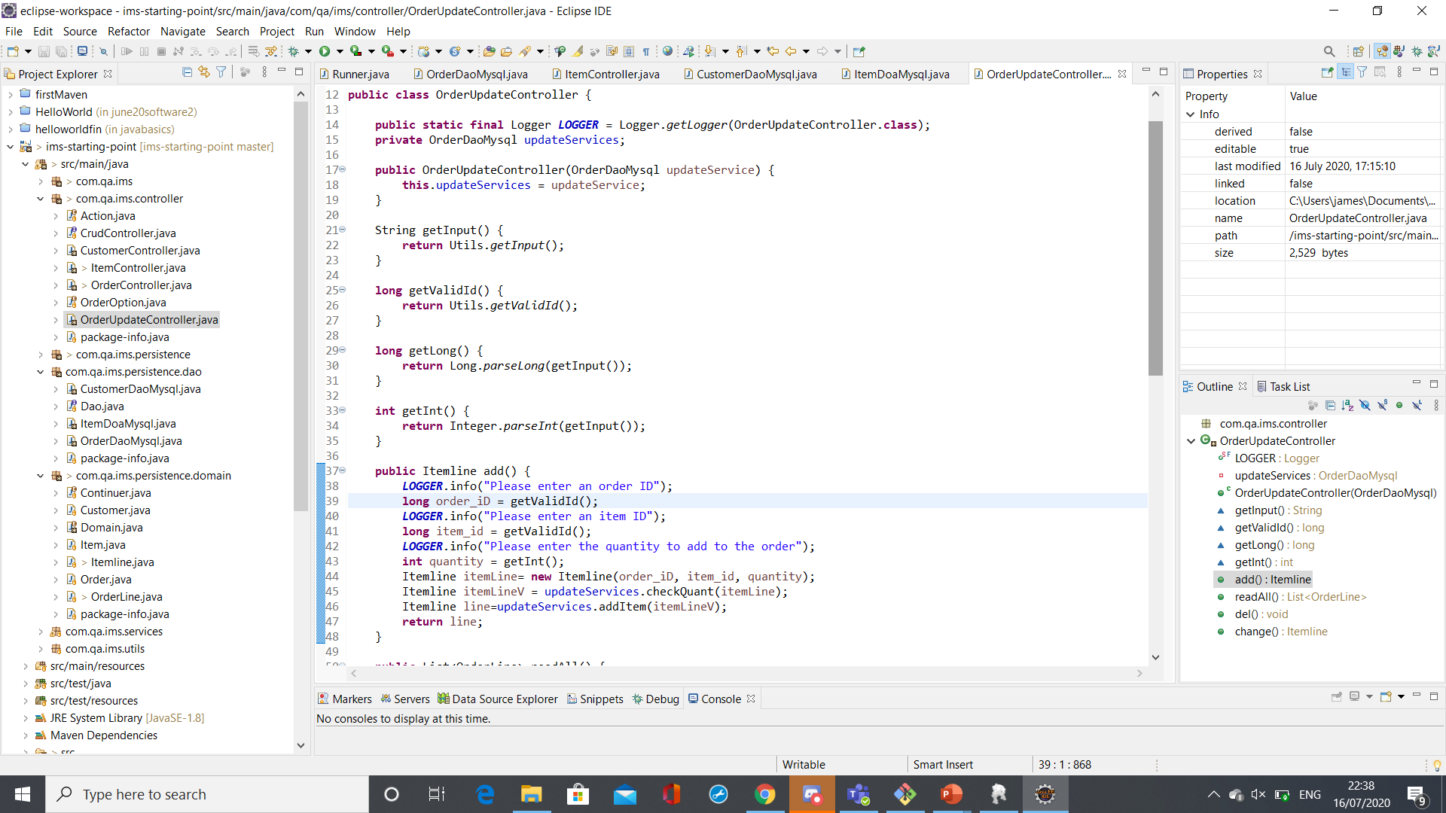
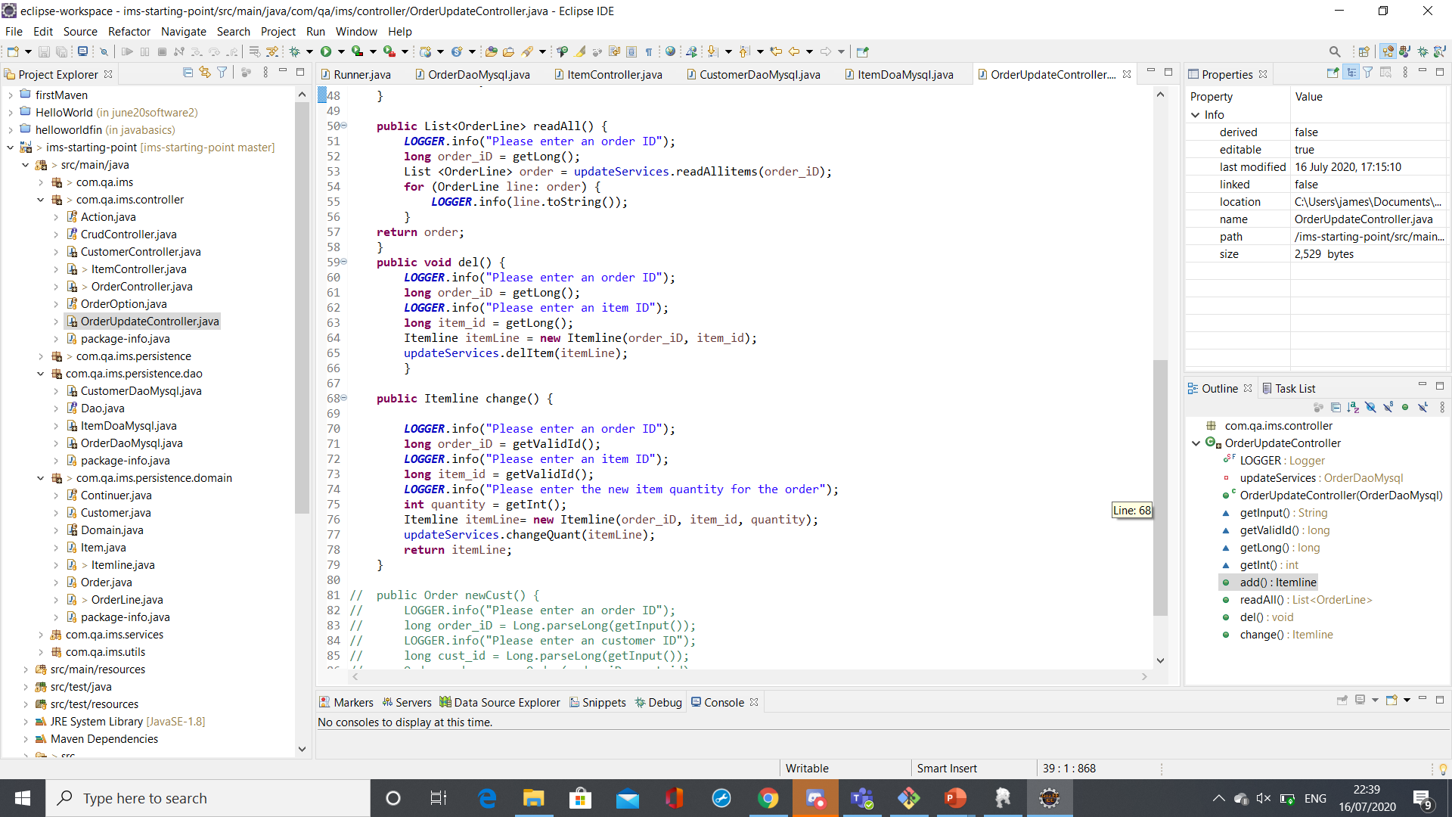
OrderUpdateController

Slide 15
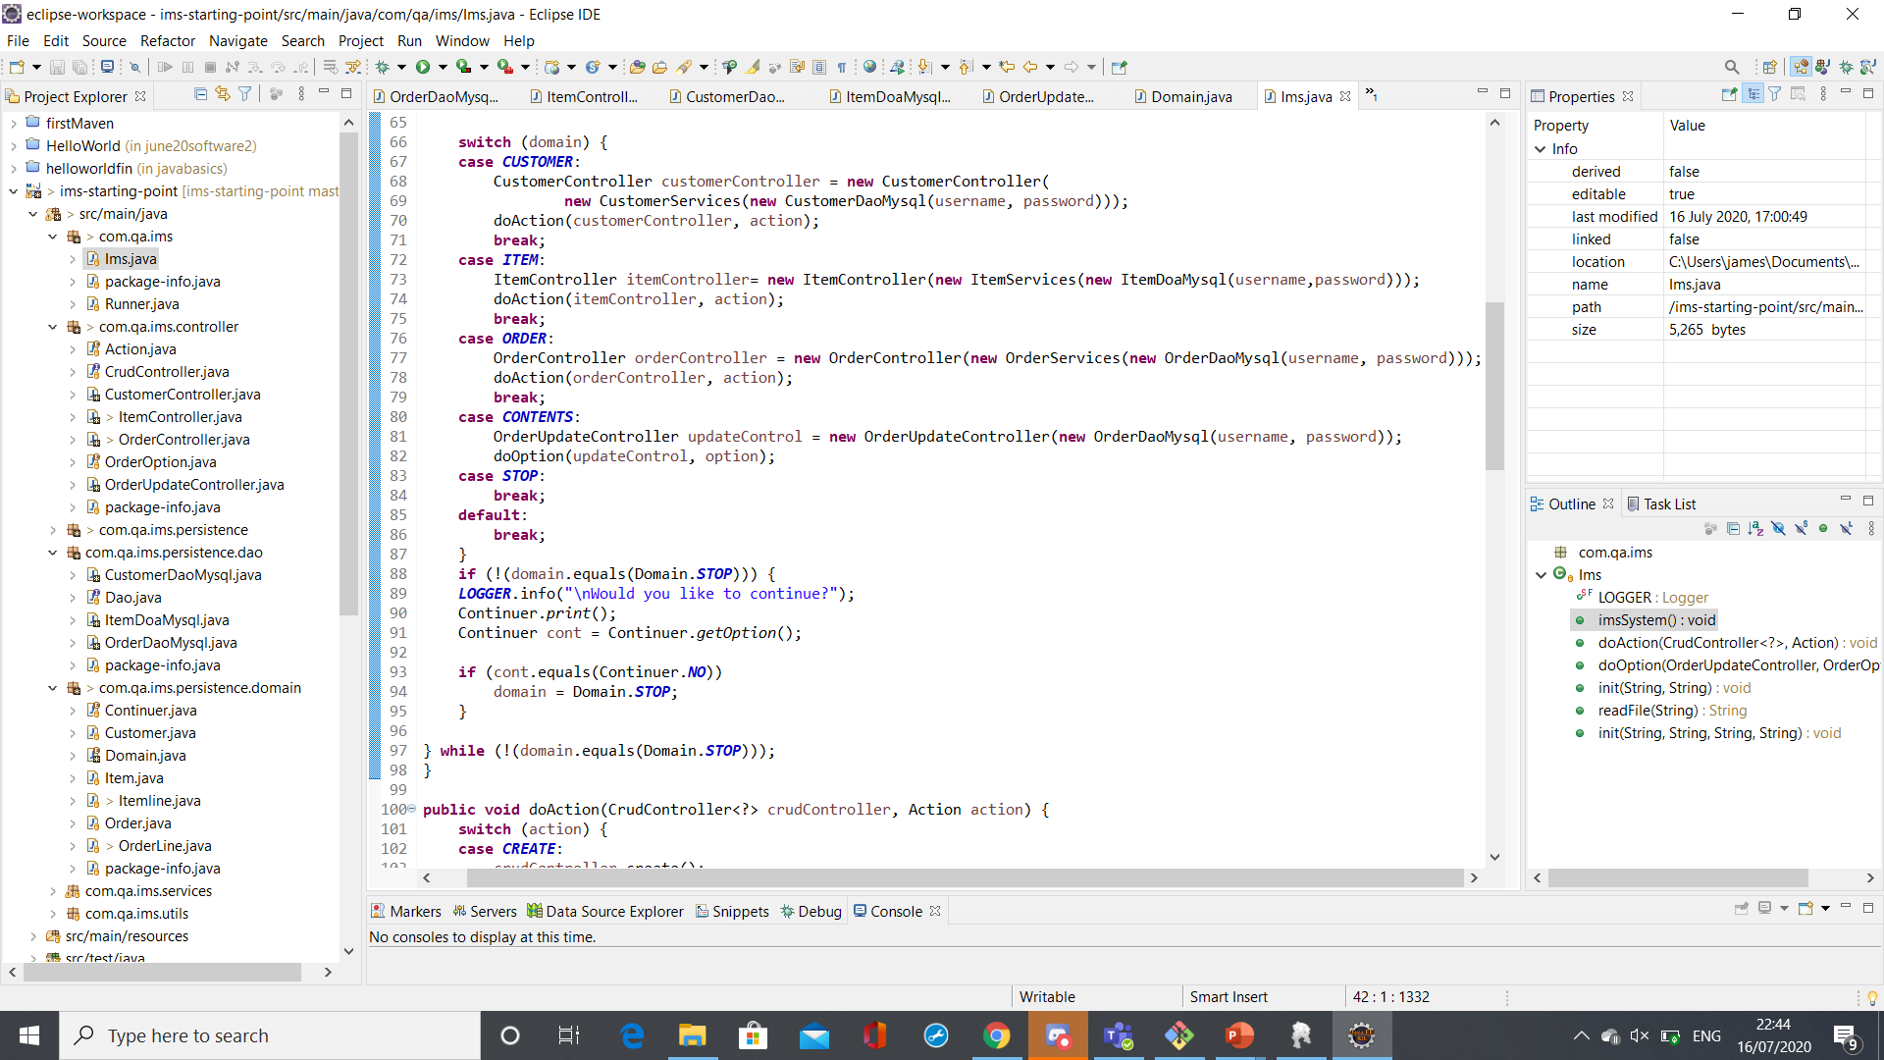
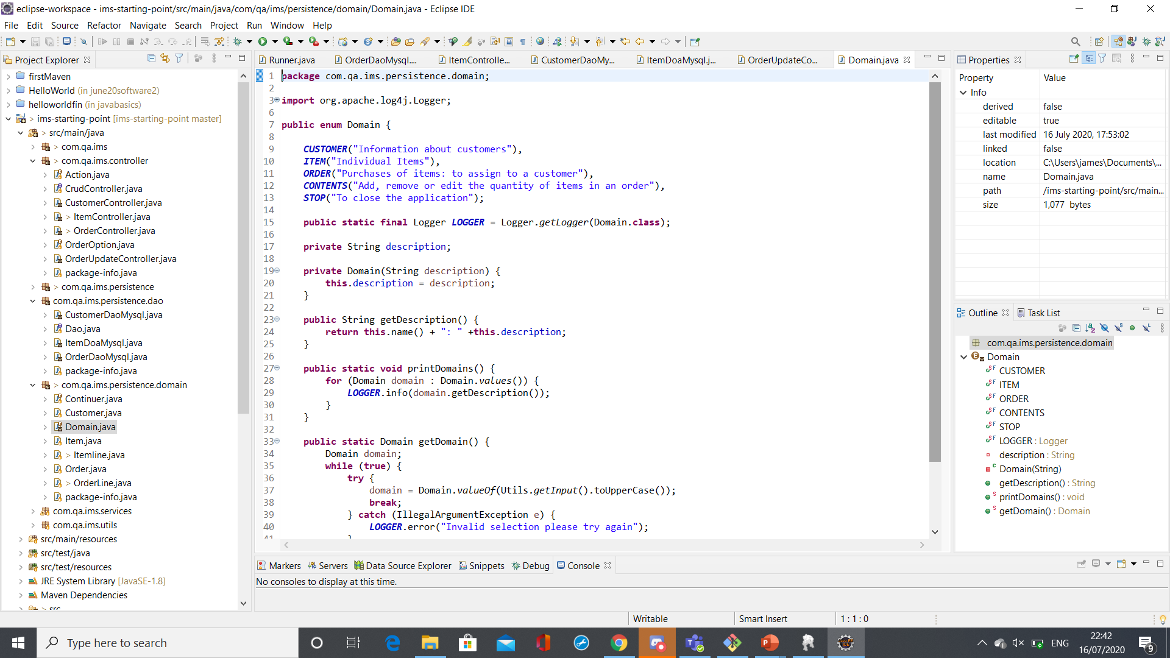
Contents option

Slide 16
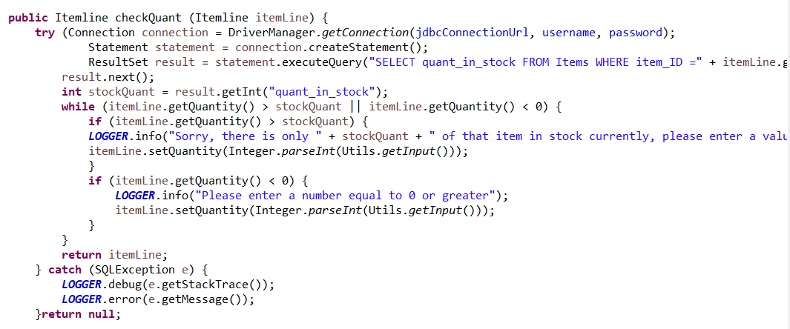
Contents Dao methods

Slide 17
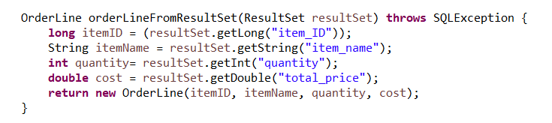
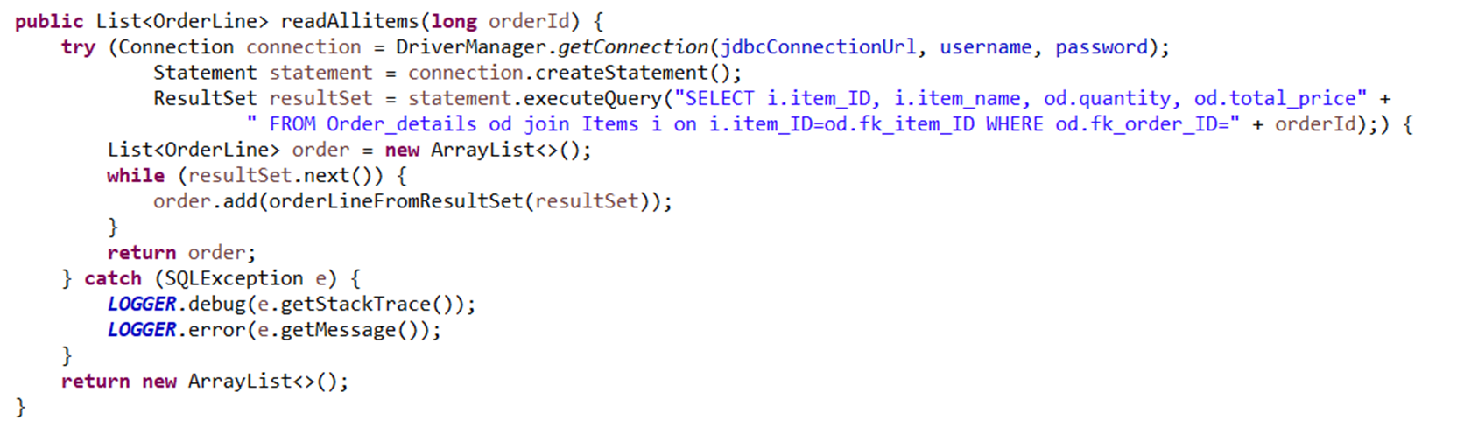
Contents Dao methods

Slide 18
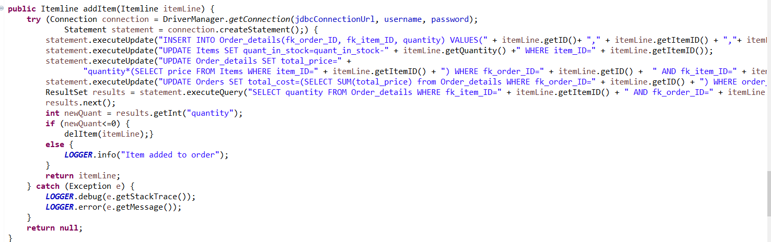
Contents Dao methods

Slide 19
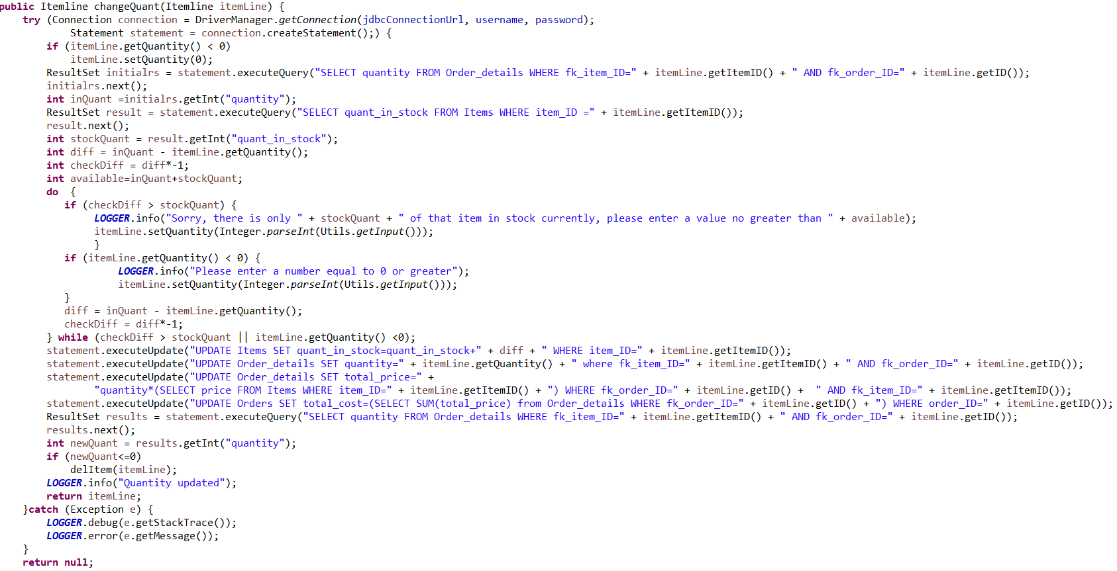
Contents Dao methods

Slide 20
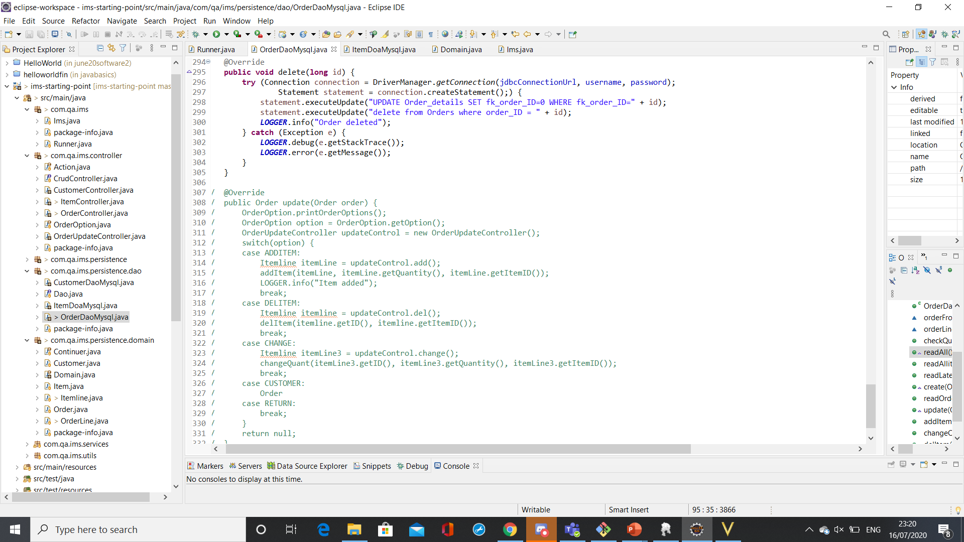
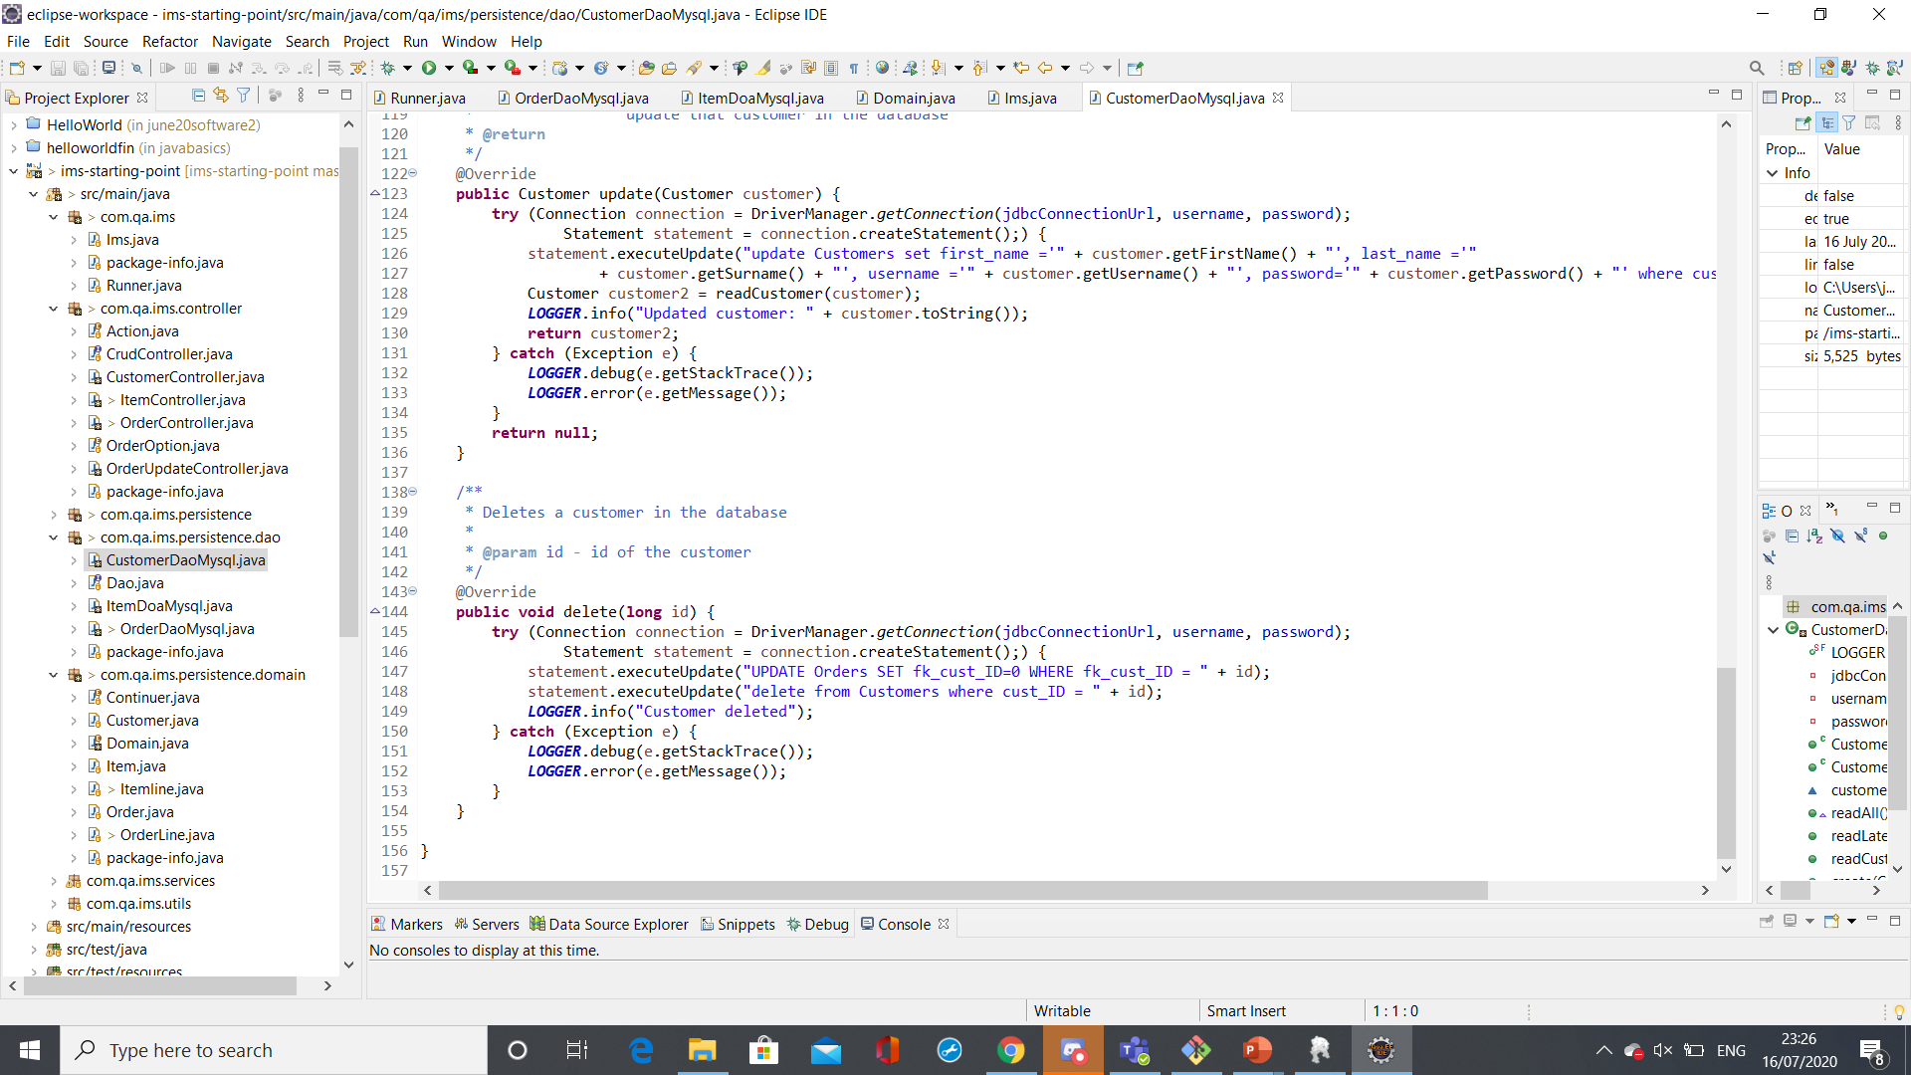
Delete methods

Slide 21
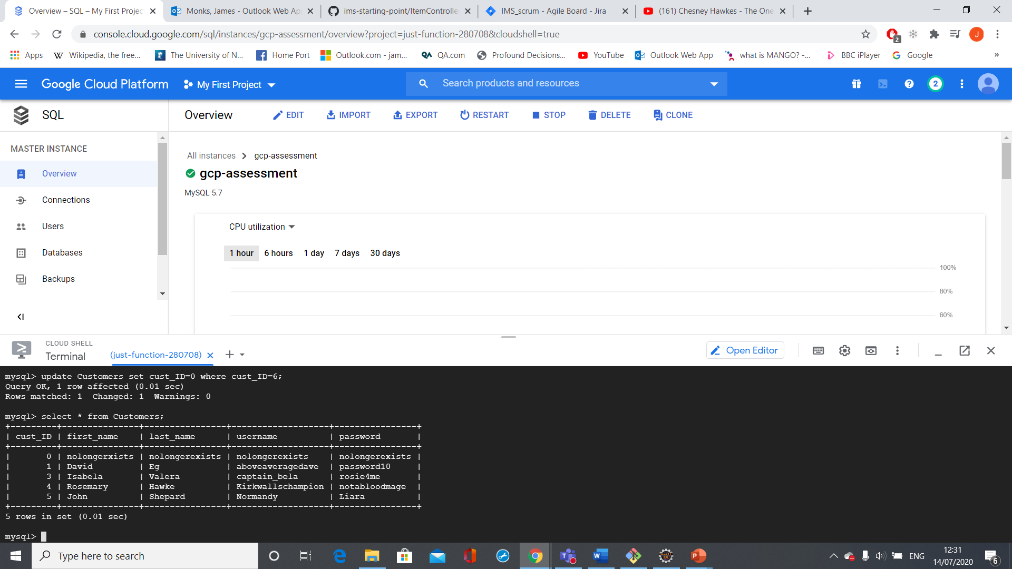


item0

Slide 22
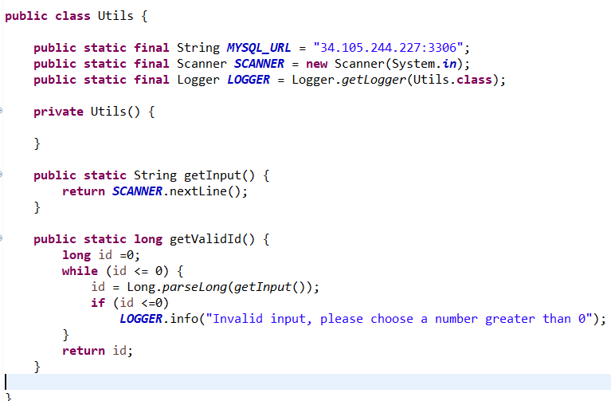
getValidId

Slide 23
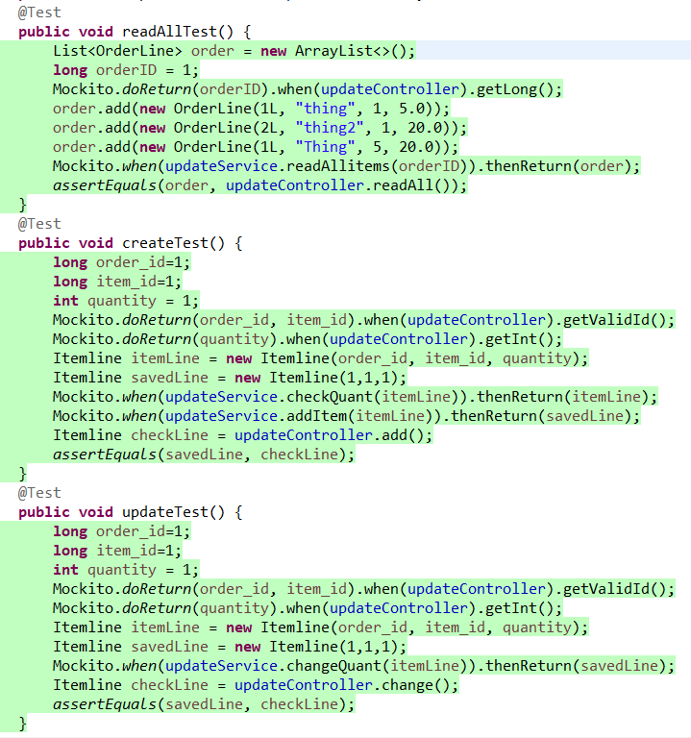
Testing

Slide 24
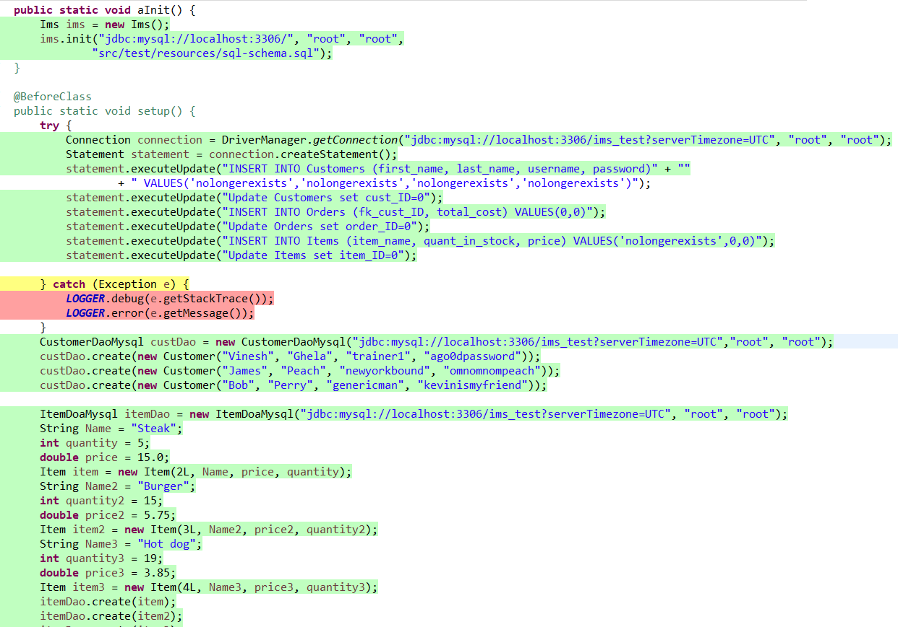
Testing

Slide 25
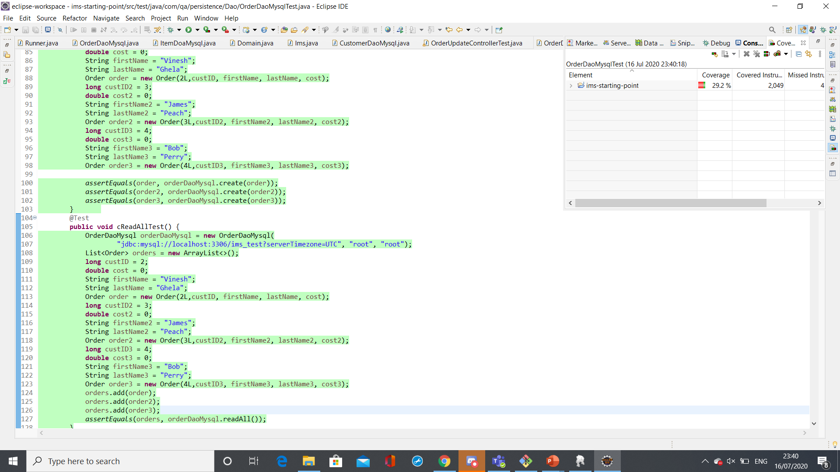
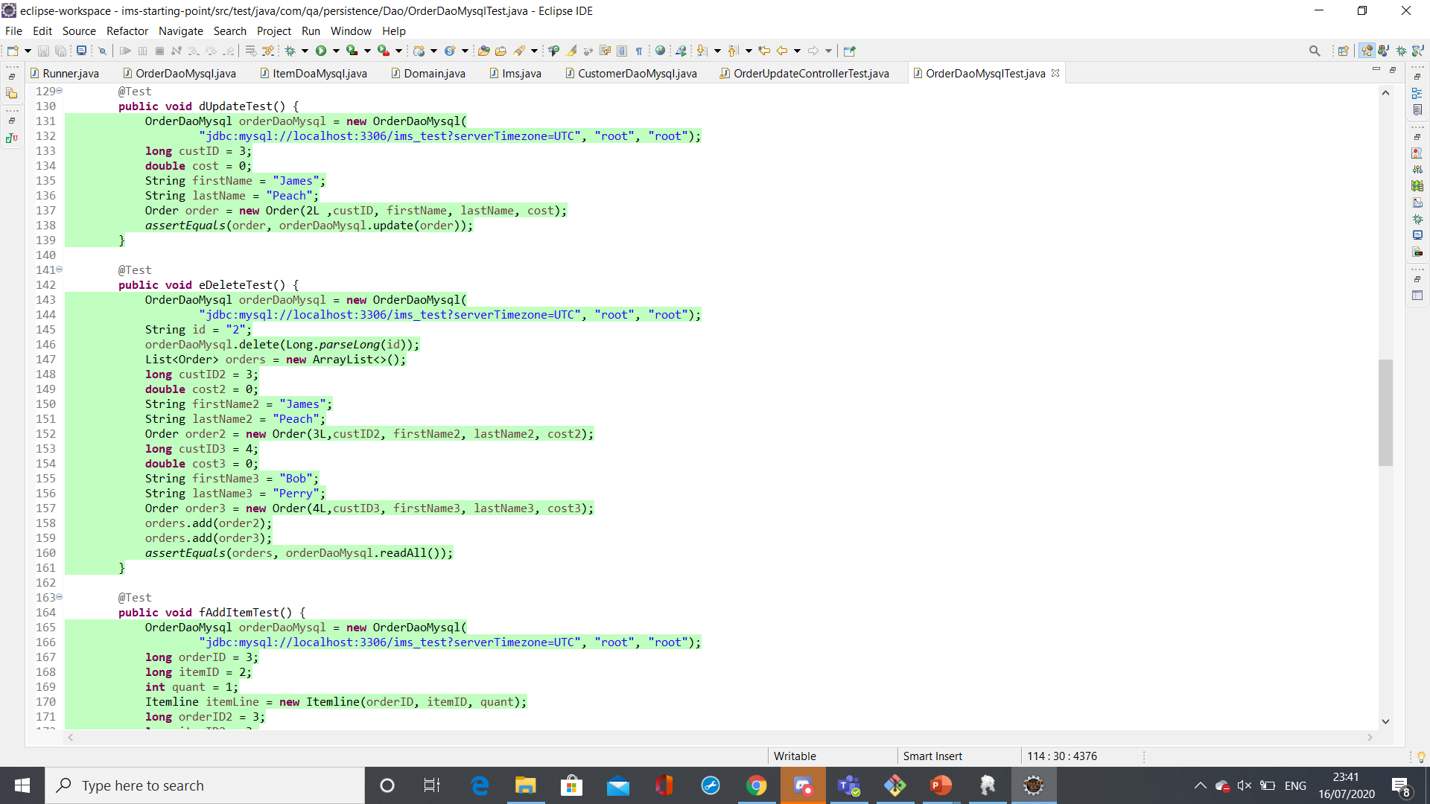
Testing

Slide 26
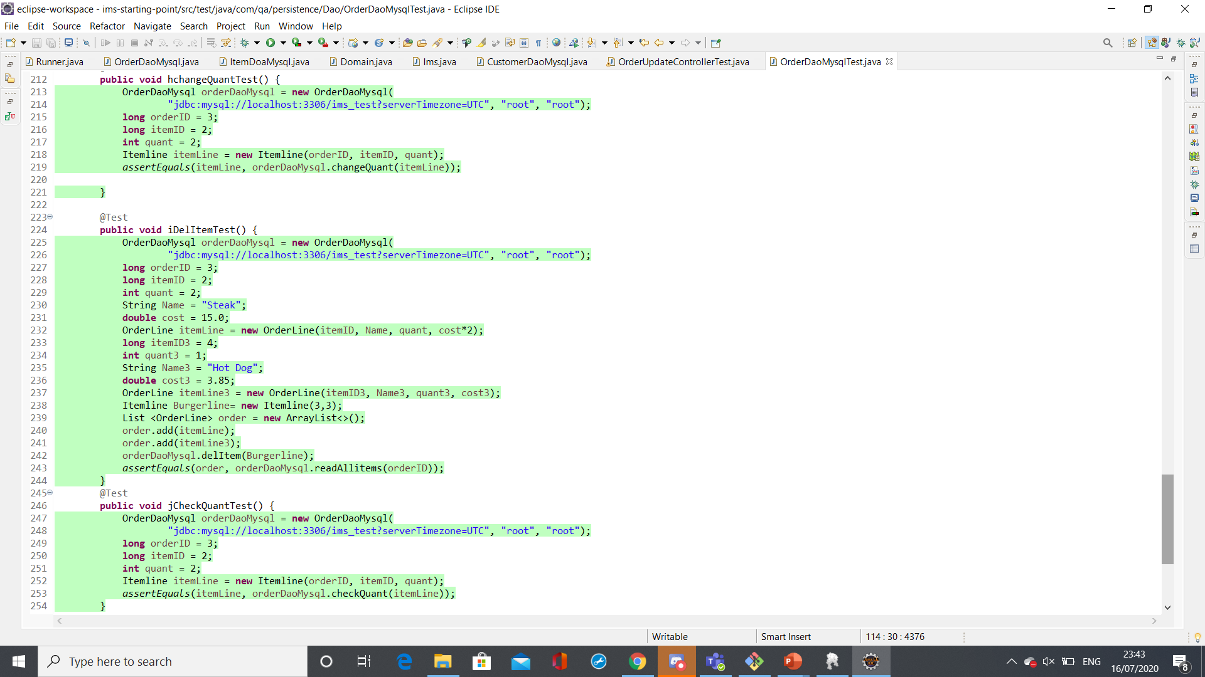
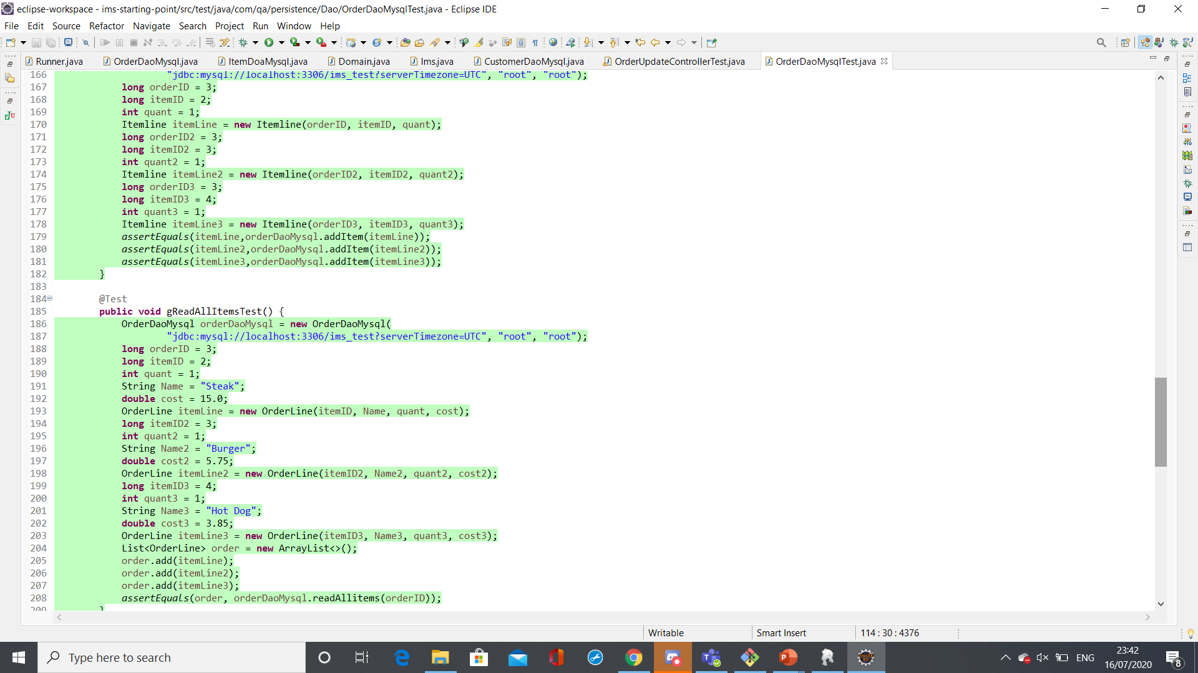
Testing

Slide 27
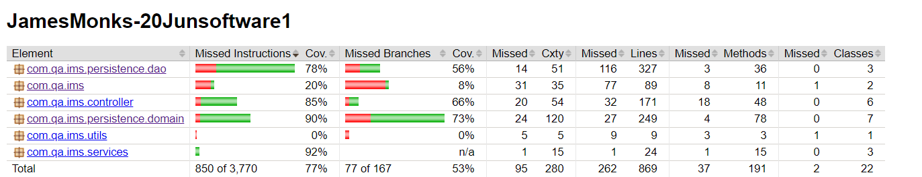
Testing

Slide 28
Demo time

Slide 29
Conclusions
A functioning inventory management system was developed, allowing CRUD functionality for customers, orders and items: both in stock and in orders
Measures were implemented to ensure that users cannot break the application or cause unwanted effects
The system has been tested manually and with Junit and 77% coverage has been achieved.

Slide 30
Future Work
Roll Itemline into OrderLine
Make unit tests for all classes, covering more of the project
Edit contents through an option after selecting order
Show possible options when selecting Ids
Display clear error messages when a command does nothing due to an invalid value entered.
Give an opportunity to reenter any value that would not be valid for any reason.

